Slide 1
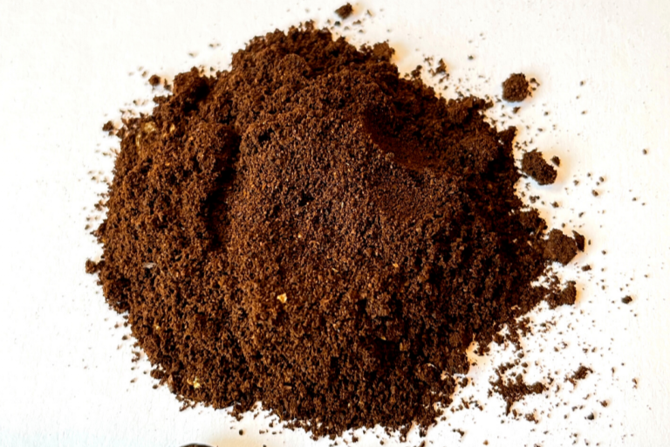
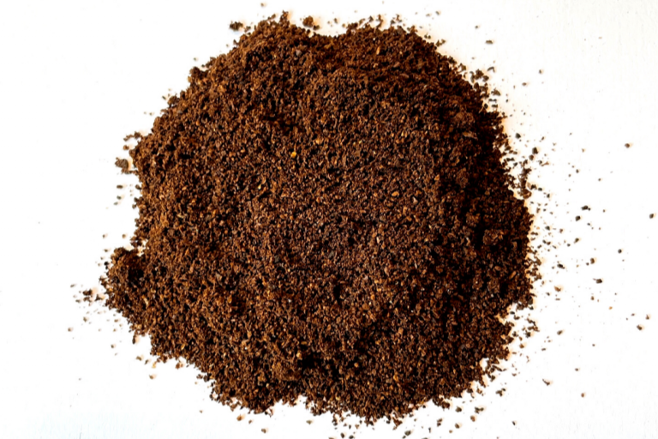
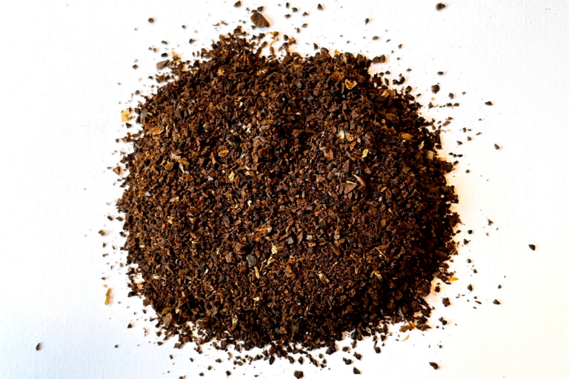
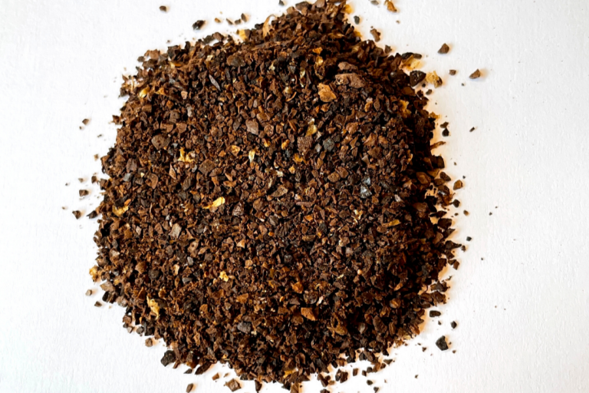
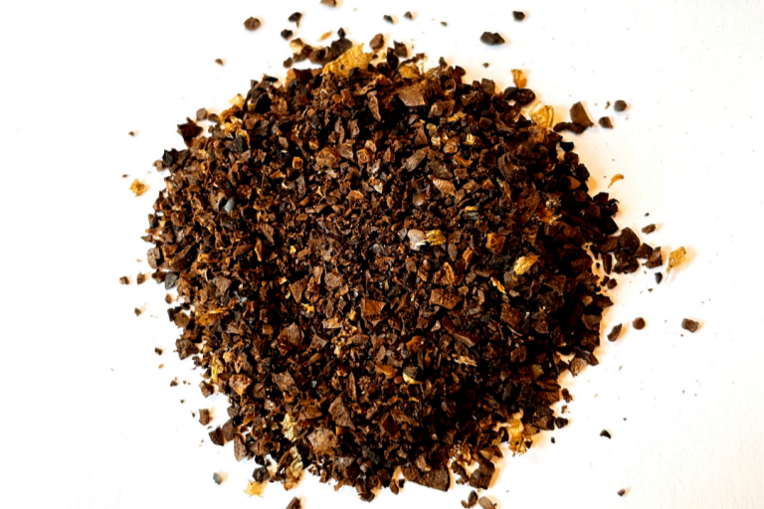
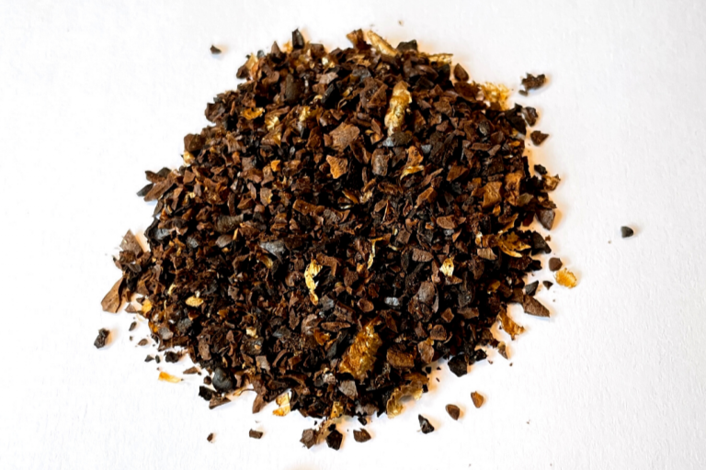
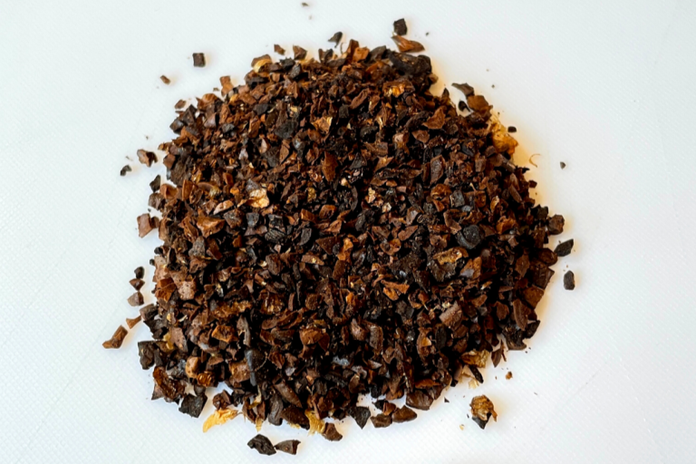
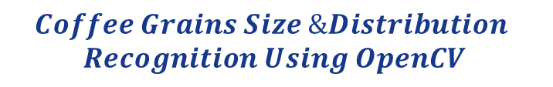

HOMEWORK Final Project
ECE/CS 8690 2302 Computer Vision
$$Coffee Grains Size \&Distribution$$
$$Recognition Using OpenCV$$
Xuanbo Miao
14422044
xmiao@mail.missouri.edu
Abstract
This assignment focuses on implementing a basic pipeline for feature detection, description, and matching. The first step is feature detection, which involves computing the autocorrelation matrix and a scalar feature detection measure using a formula discussed in class. The detected feature points are then shown in the image and included in the report. The second step is feature matching and evaluation, which involves defining and describing a feature descriptor and using it to match features using three different strategies. The performance of the feature matching is evaluated using transformation/homography matrices provided with the data.

Slide 2
Introduction - Problem Being Solved
Dataset: I have get one of my dataset like below, since I am doing CV project, I won’t needa a huge dataset currently, I’ll just use it to make some basic code.
They are at different grinding size:
Coding: a part of coding is accomplished:
import cv2
import os
import numpy as np
import matplotlib.pyplot as plt
import pandas as pd
# Constants
IMAGE_DIR = "./CV2023_FinalProj/testData_1/"
def load_images(directory):
# Load images from the directory
images = []
for file in os.listdir(directory):
if file.endswith((".jpg", ".jpeg", ".png")):
img_path = os.path.join(directory, file)
img = cv2.imread(img_path)
images.append(img)
return images
def unify_contrast_brightness(image):
# Compute the minimum and maximum pixel values in the image
min_val, max_val, _, _ = cv2.minMaxLoc(image)
# Normalize the pixel values to span the full range of 0 to 255
if max_val > min_val:
normalized = ((image - min_val) / (max_val - min_val)) * 255
else:
normalized = image.copy()
# Convert the pixel values to the range of 0 to 255
normalized = np.uint8(normalized)
# Apply a histogram equalization to improve contrast
equalized = cv2.equalizeHist(normalized) # type: ignore
return equalized
def auto_correlation_matrix(image, window_size=3):
# Compute the derivatives of the image using Sobel kernels
Ix = cv2.Sobel(image, cv2.CV_32F, 1, 0, ksize=3)
Iy = cv2.Sobel(image, cv2.CV_32F, 0, 1, ksize=3)
# Compute the elements of the structure tensor
auto_rr_matrix_xx = cv2.GaussianBlur(Ix**2, (window_size, window_size), 0)
auto_rr_matrix_yy = cv2.GaussianBlur(Iy**2, (window_size, window_size), 0)
auto_rr_matrix_xy = cv2.GaussianBlur(Ix*Iy, (window_size, window_size), 0)
auto_rr_matrix = [auto_rr_matrix_xx, auto_rr_matrix_yy, auto_rr_matrix_xy]
return auto_rr_matrix
def preprocess_image(image):
# Convert the image to Lab color space
lab_img = cv2.cvtColor(image, cv2.COLOR_BGR2Lab)
# Split the Lab image into L, a, and b channels
L_channel, _, _ = cv2.split(lab_img)
# Apply Gaussian blur to reduce noise
blurred_img = cv2.GaussianBlur(L_channel, (3, 3), 0)
# Apply contrast and brightness enhancement
enhanced_image = unify_contrast_brightness(blurred_img)
# Compute the auto-correlation matrix
auto_corr_matrix = auto_correlation_matrix(enhanced_image)
return enhanced_image, auto_corr_matrix
def DetectAndCompute(image, max_points):
sift = cv2.SIFT_create()
keypoints = sift.detect(image)
keypoints = sorted(keypoints, key=lambda x: x.response, reverse=True)
keypoints = keypoints[:max_points]
keypoints, descriptors = sift.compute(image, keypoints)
descriptors = descriptors[:max_points]
return keypoints, descriptors
def extract_features(image):
max_points = 1000
keypoints, descriptors = DetectAndCompute(image, max_points)
# Calculate the average area of keypoints
areas = [kp.size for kp in keypoints]
mean_area = np.mean(areas)
# Calculate the average color values of keypoints
colors = [image[int(kp.pt[1]), int(kp.pt[0])] for kp in keypoints]
mean_color = np.mean(colors, axis=0)
features = {
'mean_area': mean_area,
'mean_color': mean_color,
'descriptors_size': descriptors.shape[0]
}
return features
def analyze_features(features):
# Analyze the features to determine particle size, distribution, and color value
# Calculate particle size statistics
mean_size = features["mean_area"] # Use 'mean_area' instead of 'areas'
std_dev_size = np.std(features["mean_area"])
# Calculate color value statistics
mean_color = features["mean_color"]
# Create a dictionary to store the results
results = {
"mean_size": mean_size,
"std_dev_size": std_dev_size,
"mean_color": mean_color,
}
return results
def display_results(results):
# Display the results in a user interface
# Print results to the console (simple example)
print(f"Mean Particle Size: {results['mean_size']:.2f}")
print(
f"Standard Deviation of Particle Size: {results['std_dev_size']:.2f}")
print(f"Mean Color Value (B, G, R): {tuple(results['mean_color'])}")
def main():
# Step 1: Image Acquisition
images = load_images(IMAGE_DIR)
# Step 2: Image Preprocessing
preprocessed_images = [preprocess_image(img)[0] for img in images]
# Step 3: Feature Extraction
feature_list = [extract_features(img) for img in preprocessed_images]
# Step 4: Data Analysis
analysis_results = [analyze_features(features)
for features in feature_list]
# Step 5: Display the results
for idx, results in enumerate(analysis_results):
print(f"Results for Image {idx + 1}:")
display_results(results)
print()
# Step 6: Testing and Validation
# Compare the system's results to manual measurements
pass
if __name__ == "__main__":
main()
import cv2
import os
import numpy as np
import matplotlib.pyplot as plt
import pandas as pd
# Constants
IMAGE_DIR = "./CV2023_FinalProj/testData_1/"
def load_images(directory):
# Load images from the directory
images = []
for file in os.listdir(directory):
if file.endswith((".jpg", ".jpeg", ".png")):
img_path = os.path.join(directory, file)
img = cv2.imread(img_path)
images.append(img)
return images
def unify_contrast_brightness(image):
# Compute the minimum and maximum pixel values in the image
min_val, max_val, _, _ = cv2.minMaxLoc(image)
# Normalize the pixel values to span the full range of 0 to 255
if max_val > min_val:
normalized = ((image - min_val) / (max_val - min_val)) * 255
else:
normalized = image.copy()
# Convert the pixel values to the range of 0 to 255
normalized = np.uint8(normalized)
# Apply a histogram equalization to improve contrast
equalized = cv2.equalizeHist(normalized) # type: ignore
return equalized
def auto_correlation_matrix(image, window_size=3):
# Compute the derivatives of the image using Sobel kernels
Ix = cv2.Sobel(image, cv2.CV_32F, 1, 0, ksize=3)
Iy = cv2.Sobel(image, cv2.CV_32F, 0, 1, ksize=3)
# Compute the elements of the structure tensor
auto_rr_matrix_xx = cv2.GaussianBlur(Ix**2, (window_size, window_size), 0)
auto_rr_matrix_yy = cv2.GaussianBlur(Iy**2, (window_size, window_size), 0)
auto_rr_matrix_xy = cv2.GaussianBlur(Ix*Iy, (window_size, window_size), 0)
auto_rr_matrix = [auto_rr_matrix_xx, auto_rr_matrix_yy, auto_rr_matrix_xy]
return auto_rr_matrix
def preprocess_image(image):
# Convert the image to Lab color space
lab_img = cv2.cvtColor(image, cv2.COLOR_BGR2Lab)
# Split the Lab image into L, a, and b channels
L_channel, _, _ = cv2.split(lab_img)
# Apply Gaussian blur to reduce noise
blurred_img = cv2.GaussianBlur(L_channel, (3, 3), 0)
# Apply contrast and brightness enhancement
enhanced_image = unify_contrast_brightness(blurred_img)
# Compute the auto-correlation matrix
auto_corr_matrix = auto_correlation_matrix(enhanced_image)
return enhanced_image, auto_corr_matrix
def DetectAndCompute(image, max_points):
sift = cv2.SIFT_create()
keypoints = sift.detect(image)
keypoints = sorted(keypoints, key=lambda x: x.response, reverse=True)
keypoints = keypoints[:max_points]
keypoints, descriptors = sift.compute(image, keypoints)
descriptors = descriptors[:max_points]
return keypoints, descriptors
def extract_features(image):
max_points = 1000
keypoints, descriptors = DetectAndCompute(image, max_points)
# Calculate the average area of keypoints
areas = [kp.size for kp in keypoints]
mean_area = np.mean(areas)
# Calculate the average color values of keypoints
colors = [image[int(kp.pt[1]), int(kp.pt[0])] for kp in keypoints]
mean_color = np.mean(colors, axis=0)
features = {
'mean_area': mean_area,
'mean_color': mean_color,
'descriptors_size': descriptors.shape[0]
}
return features
def analyze_features(features):
# Analyze the features to determine particle size, distribution, and color value
# Calculate particle size statistics
mean_size = features["mean_area"] # Use 'mean_area' instead of 'areas'
std_dev_size = np.std(features["mean_area"])
# Calculate color value statistics
mean_color = features["mean_color"]
# Create a dictionary to store the results
results = {
"mean_size": mean_size,
"std_dev_size": std_dev_size,
"mean_color": mean_color,
}
return results
def display_results(results):
# Display the results in a user interface
# Print results to the console (simple example)
print(f"Mean Particle Size: {results['mean_size']:.2f}")
print(
f"Standard Deviation of Particle Size: {results['std_dev_size']:.2f}")
print(f"Mean Color Value (B, G, R): {tuple(results['mean_color'])}")
def main():
# Step 1: Image Acquisition
images = load_images(IMAGE_DIR)
# Step 2: Image Preprocessing
preprocessed_images = [preprocess_image(img)[0] for img in images]
# Step 3: Feature Extraction
feature_list = [extract_features(img) for img in preprocessed_images]
# Step 4: Data Analysis
analysis_results = [analyze_features(features)
for features in feature_list]
# Step 5: Display the results
for idx, results in enumerate(analysis_results):
print(f"Results for Image {idx + 1}:")
display_results(results)
print()
# Step 6: Testing and Validation
# Compare the system's results to manual measurements
pass
if __name__ == "__main__":
main()

Slide 3
Background - Previous Work
Image Processing Techniques
Image segmentation
Edge detection
Morphological operations
Subtitle: Particle Sizing Methods
Watershed segmentation: divides image into regions based on pixel intensity
Connected component labeling: detects groups of connected pixels and assigns unique labels
Feature Extraction Methods
SIFT (Scale-Invariant Feature Transform): detects and describes local features in images, robust to changes in scale, rotation, and illumination
ORB (Oriented FAST and Rotated BRIEF): an alternative to SIFT, faster and more efficient, but less robust to scale changes
Challenges in Previous Work
Noise: image degradation due to sensor noise or external factors
Varying particle sizes: handling particles with different sizes in the same image
Irregular shapes: accurately identifying and measuring particles with non-uniform shapes
Visuals
Include examples of watershed segmentation and connected component labeling results
Display SIFT and ORB keypoints on images
Show examples of images with noise, varying particle sizes, and irregular shapes

Slide 4
Proposed Solution - Algorithm and Novelty
Steps
Image Acquisition: Load images from a specified directory.
Image Preprocessing:
Convert the image to Lab color space.
Apply Gaussian blur to reduce noise.
Enhance contrast and brightness using histogram equalization.
Compute the auto-correlation matrix.
Feature Extraction:
Use SIFT to extract keypoints and descriptors.
Calculate the average area and color values of keypoints.
Data Analysis:
Calculate particle size statistics (mean, standard deviation).
Determine mean color value.
Display the results.
Testing and Validation: Compare the system's results to manual measurements.
Novelty
Unified contrast and brightness enhancement to improve the quality of images with varying illumination and poor contrast.
The use of the auto-correlation matrix to identify regions of interest in the images, improving the efficiency and accuracy of the feature extraction process.
Robust feature extraction using SIFT, allowing for more reliable analysis of particles in complex images.
Visuals
Flowchart or diagram illustrating the steps in the algorithm.
Example input image and preprocessed output.
SIFT keypoints and descriptors overlaid on an image.
Example of displayed results.
import cv2
import os
import numpy as np
import matplotlib.pyplot as plt
import pandas as pd
# Constants
IMAGE_DIR = "./CV2023_FinalProj/testData_1/"
def load_images(directory):
# Load images from the directory
images = []
for file in os.listdir(directory):
if file.endswith((".jpg", ".jpeg", ".png")):
img_path = os.path.join(directory, file)
img = cv2.imread(img_path)
images.append(img)
return images
def unify_contrast_brightness(image):
# Compute the minimum and maximum pixel values in the image
min_val, max_val, _, _ = cv2.minMaxLoc(image)
# Normalize the pixel values to span the full range of 0 to 255
if max_val > min_val:
normalized = ((image - min_val) / (max_val - min_val)) * 255
else:
normalized = image.copy()
# Convert the pixel values to the range of 0 to 255
normalized = np.uint8(normalized)
# Apply a histogram equalization to improve contrast
equalized = cv2.equalizeHist(normalized) # type: ignore
return equalized
def auto_correlation_matrix(image, window_size=3):
# Compute the derivatives of the image using Sobel kernels
Ix = cv2.Sobel(image, cv2.CV_32F, 1, 0, ksize=3)
Iy = cv2.Sobel(image, cv2.CV_32F, 0, 1, ksize=3)
# Compute the elements of the structure tensor
auto_rr_matrix_xx = cv2.GaussianBlur(Ix**2, (window_size, window_size), 0)
auto_rr_matrix_yy = cv2.GaussianBlur(Iy**2, (window_size, window_size), 0)
auto_rr_matrix_xy = cv2.GaussianBlur(Ix*Iy, (window_size, window_size), 0)
auto_rr_matrix = [auto_rr_matrix_xx, auto_rr_matrix_yy, auto_rr_matrix_xy]
return auto_rr_matrix
def preprocess_image(image):
# Convert the image to Lab color space
lab_img = cv2.cvtColor(image, cv2.COLOR_BGR2Lab)
# Split the Lab image into L, a, and b channels
L_channel, _, _ = cv2.split(lab_img)
# Apply Gaussian blur to reduce noise
blurred_img = cv2.GaussianBlur(L_channel, (3, 3), 0)
# Apply contrast and brightness enhancement
enhanced_image = unify_contrast_brightness(blurred_img)
# Compute the auto-correlation matrix
auto_corr_matrix = auto_correlation_matrix(enhanced_image)
return enhanced_image, auto_corr_matrix
def DetectAndCompute(image, max_points):
sift = cv2.SIFT_create()
keypoints = sift.detect(image)
keypoints = sorted(keypoints, key=lambda x: x.response, reverse=True)
keypoints = keypoints[:max_points]
keypoints, descriptors = sift.compute(image, keypoints)
descriptors = descriptors[:max_points]
return keypoints, descriptors
def extract_features(image):
max_points = 1000
keypoints, descriptors = DetectAndCompute(image, max_points)
# Calculate the average area of keypoints
areas = [kp.size for kp in keypoints]
mean_area = np.mean(areas)
# Calculate the average color values of keypoints
colors = [image[int(kp.pt[1]), int(kp.pt[0])] for kp in keypoints]
mean_color = np.mean(colors, axis=0)
features = {
'mean_area': mean_area,
'mean_color': mean_color,
'descriptors_size': descriptors.shape[0]
}
return features
def analyze_features(features):
# Analyze the features to determine particle size, distribution, and color value
# Calculate particle size statistics
mean_size = features["mean_area"] # Use 'mean_area' instead of 'areas'
std_dev_size = np.std(features["mean_area"])
# Calculate color value statistics
mean_color = features["mean_color"]
# Create a dictionary to store the results
results = {
"mean_size": mean_size,
"std_dev_size": std_dev_size,
"mean_color": mean_color,
}
return results
def display_results(results):
# Display the results in a user interface
# Print results to the console (simple example)
print(f"Mean Particle Size: {results['mean_size']:.2f}")
print(
f"Standard Deviation of Particle Size: {results['std_dev_size']:.2f}")
print(f"Mean Color Value (B, G, R): {tuple(results['mean_color'])}")
def main():
# Step 1: Image Acquisition
images = load_images(IMAGE_DIR)
# Step 2: Image Preprocessing
preprocessed_images = [preprocess_image(img)[0] for img in images]
# Step 3: Feature Extraction
feature_list = [extract_features(img) for img in preprocessed_images]
# Step 4: Data Analysis
analysis_results = [analyze_features(features)
for features in feature_list]
# Step 5: Display the results
for idx, results in enumerate(analysis_results):
print(f"Results for Image {idx + 1}:")
display_results(results)
print()
# Step 6: Testing and Validation
# Compare the system's results to manual measurements
pass
if __name__ == "__main__":
main()

Slide 5
Evaluation - Testing and Validation
Testing and Validation Process
Collect a dataset of particle images with varying sizes, shapes, and color values.
Manually measure and annotate the particle sizes and color values in the dataset.
Run the proposed algorithm on the dataset and compare the results to the manual measurements.
Compute performance metrics such as Mean Absolute Error and Root Mean Squared Error for particle size and color value estimation.
Test the robustness of the algorithm under different conditions such as noise, poor illumination, and varying particle sizes.
Success Criteria
The algorithm should provide accurate estimations of particle sizes and color values, with low error values compared to manual measurements.
The algorithm should be robust to different image conditions and provide consistent results across various particle characteristics.
The algorithm should demonstrate better performance than existing methods in terms of accuracy, efficiency, and robustness.
Visuals
Graphs or plots showing the comparison between the algorithm's results and manual measurements.
Performance metrics (e.g., MAE and RMSE) displayed in a table or graph format.
Examples of input images with varying conditions and the corresponding algorithm's output.

Slide 6
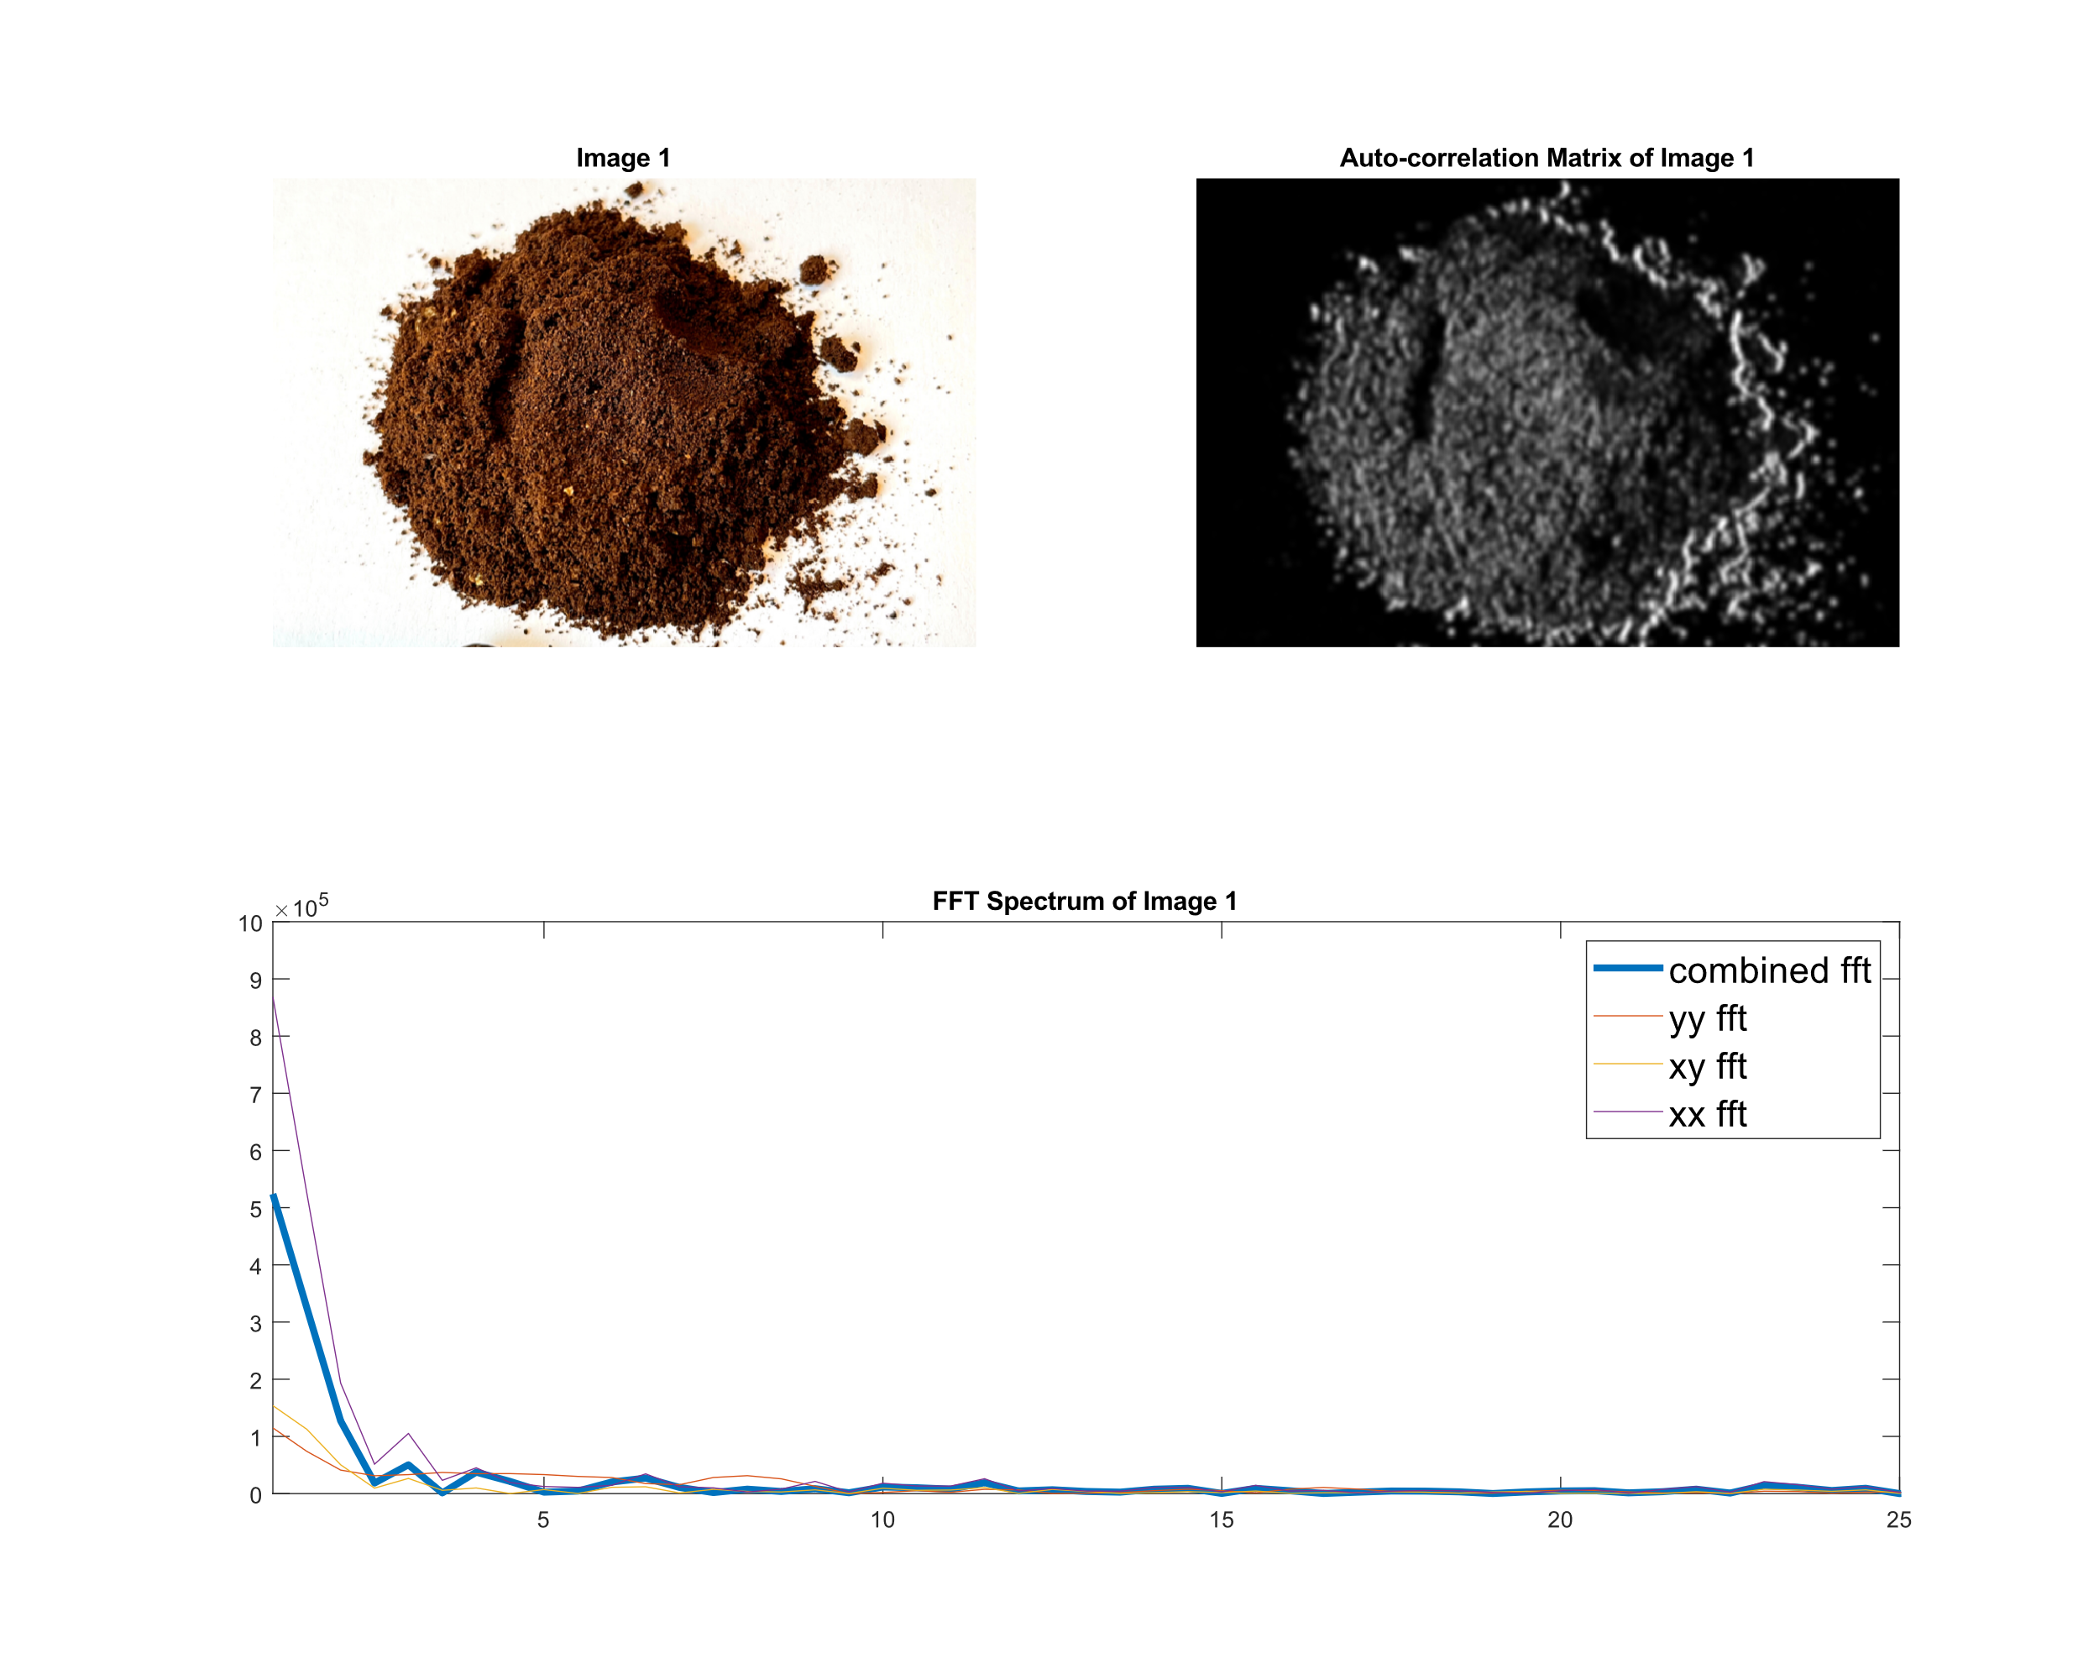
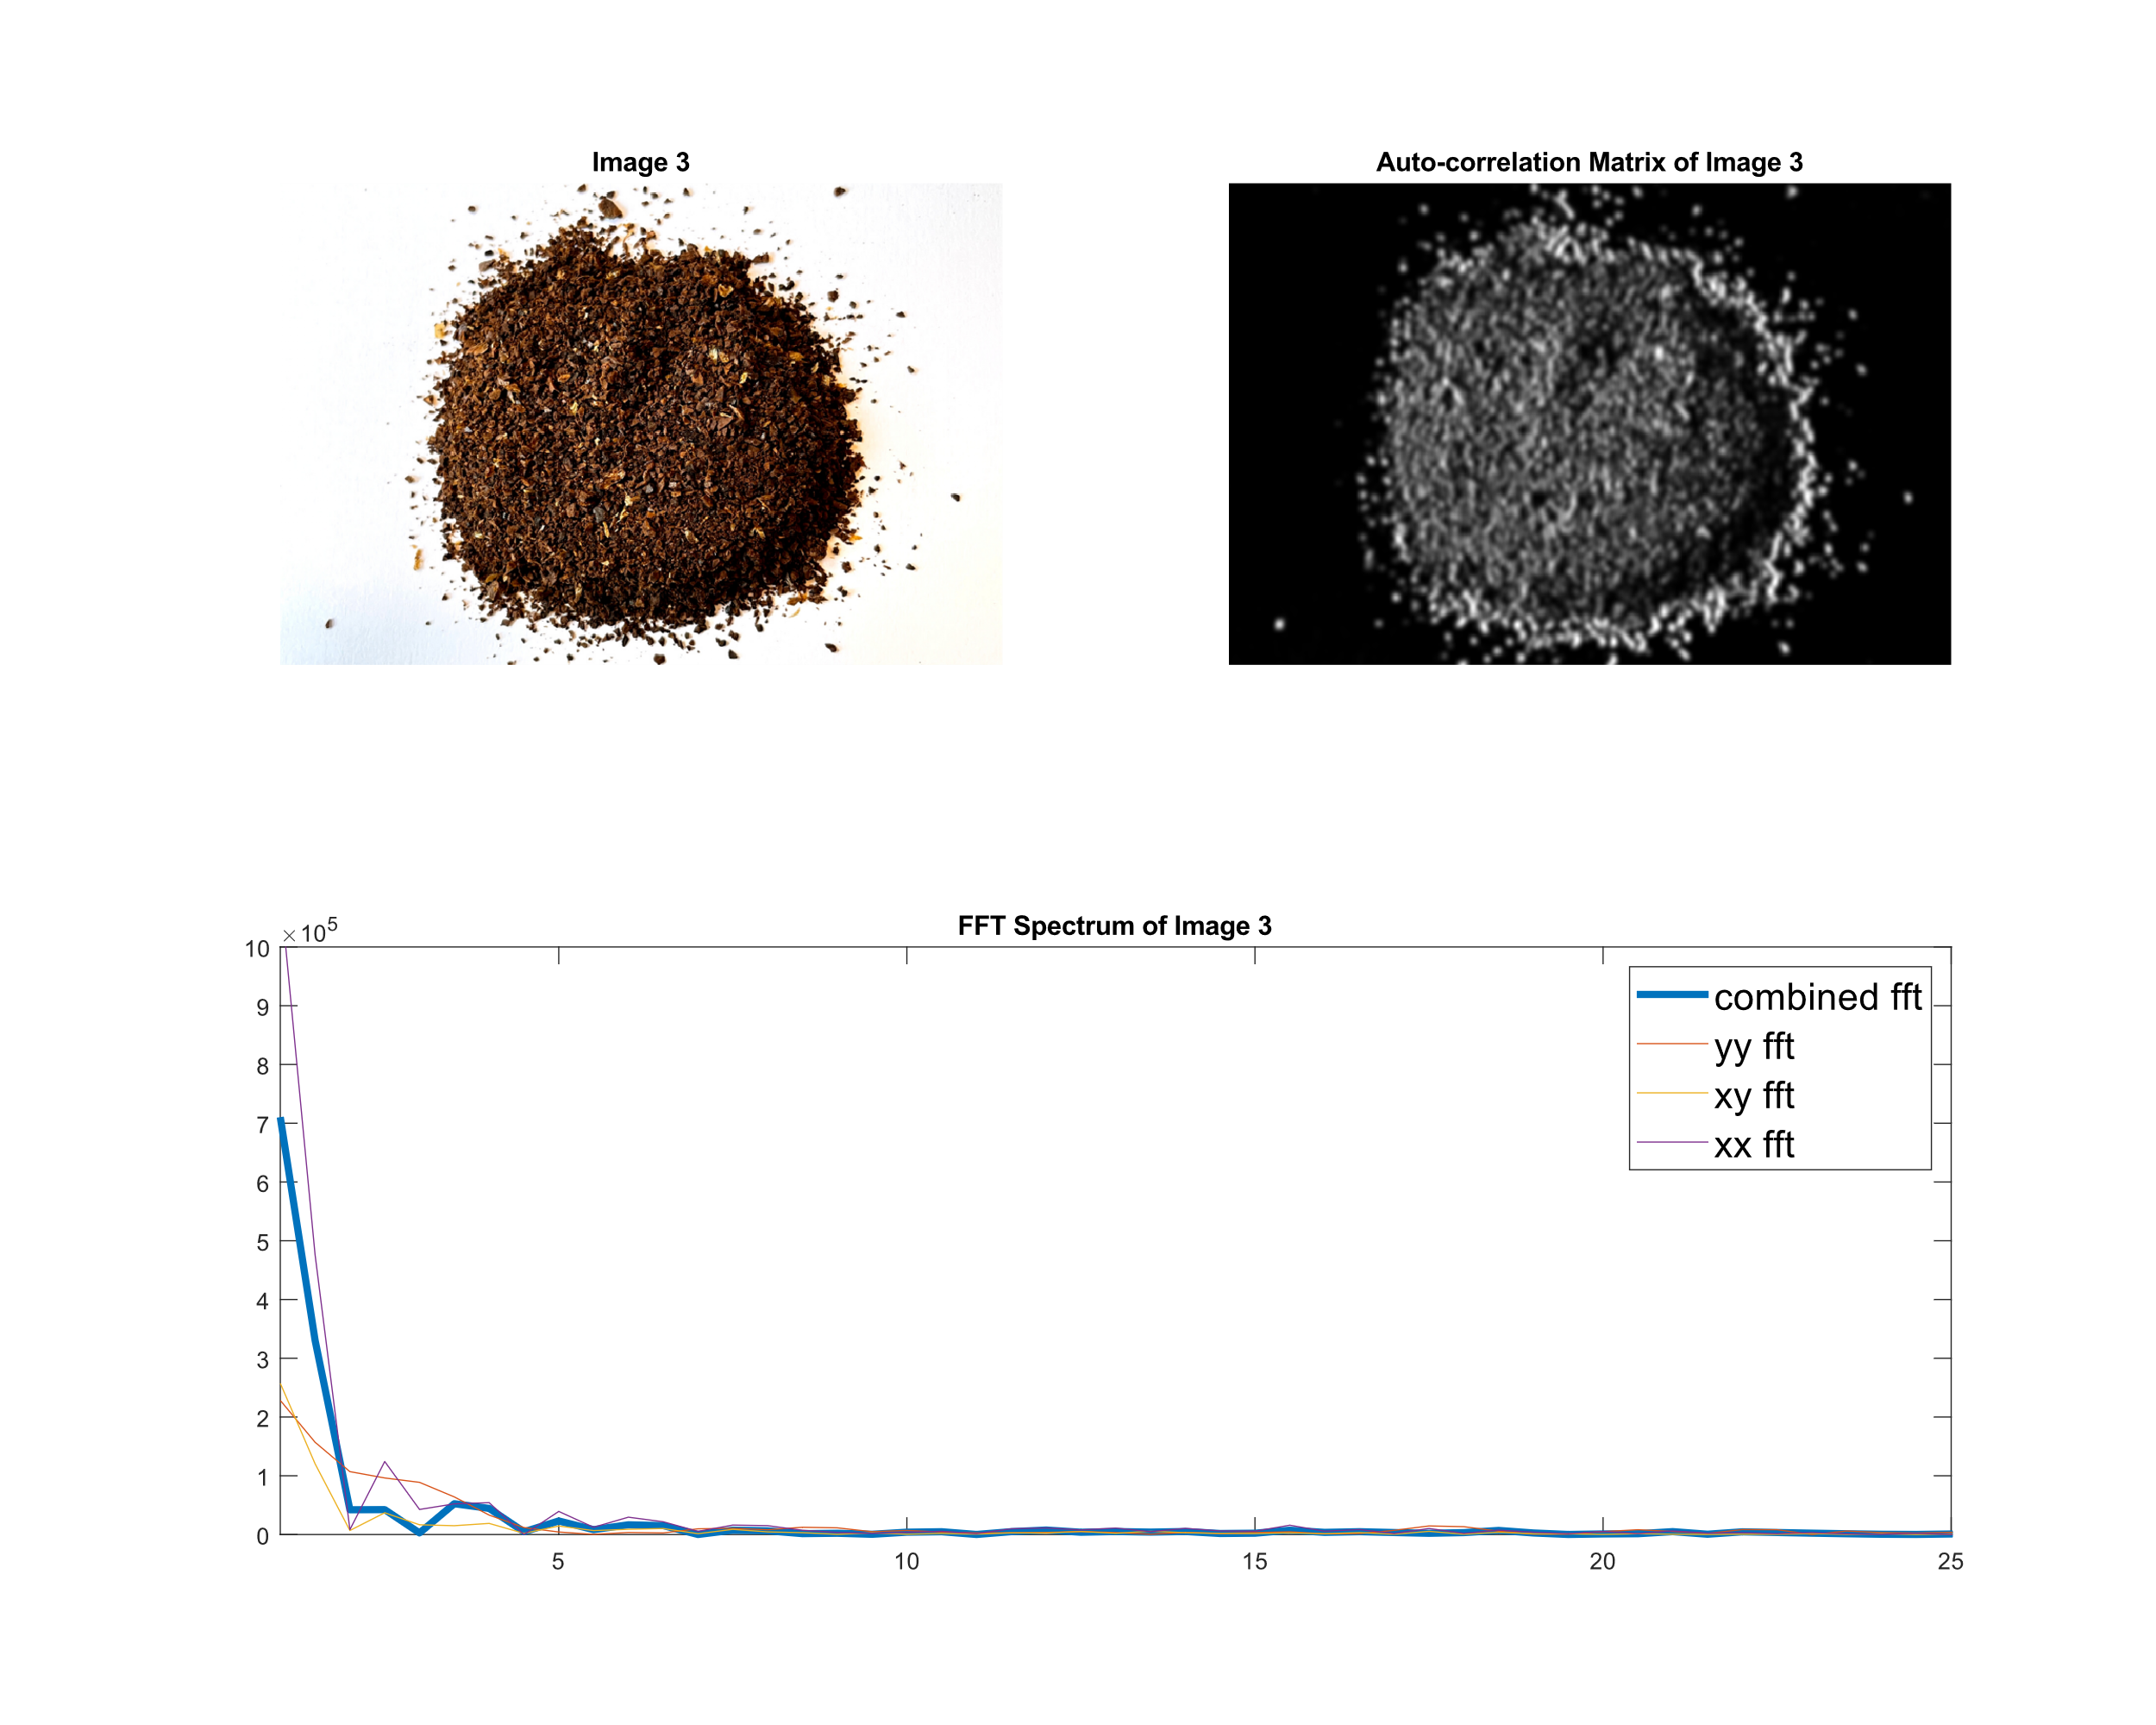
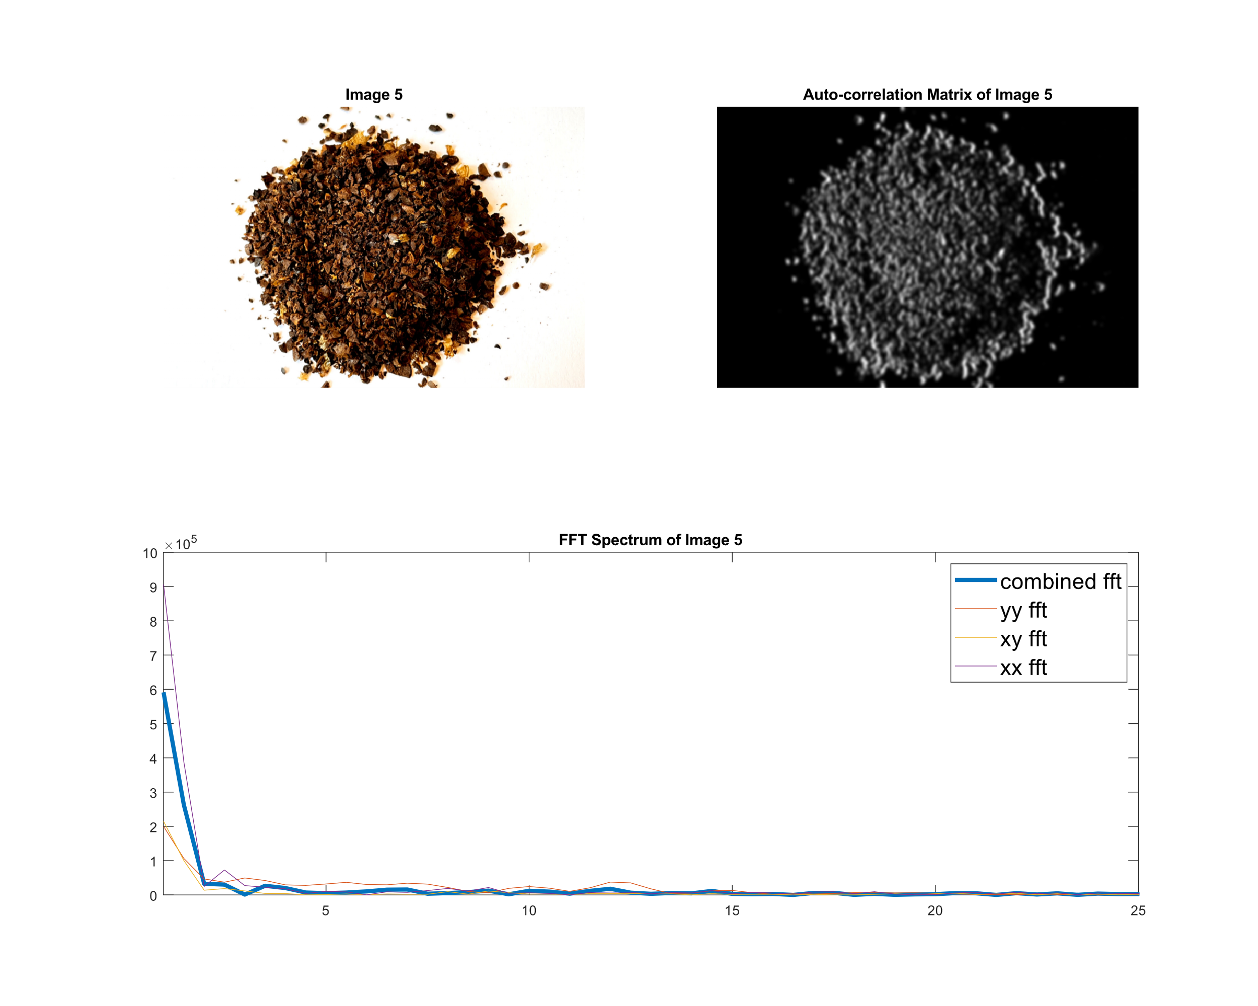
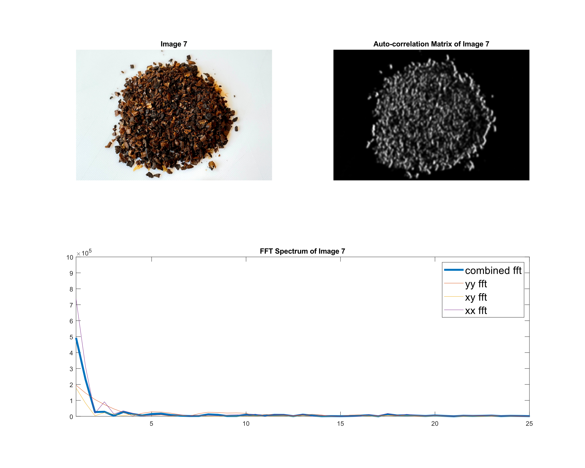

Slide 7

